Slide 1

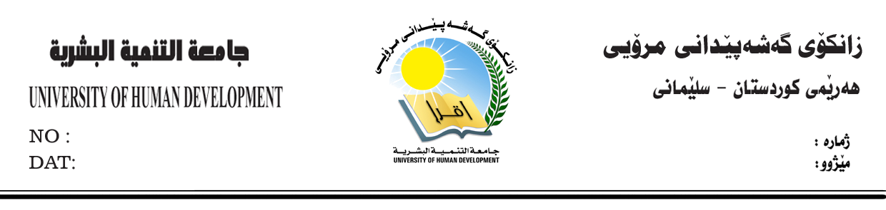
Academic Debate
Diman Moammed
diman.mohammed@uhd.edu.iq
CHAPTER 5
Six Thinking Hats
College Of Science and Technology IT/Morning

Slide 2
Outlines
Dr. Edward De Bono
Purpose
Six Thinking Hats
Results of Six Hat Thinking
References
Six Thinking Hats

Slide 3
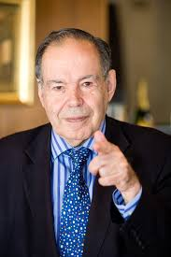
Dr. Edward De Bono
Edward De Bono (Malta 1933) is a world-known expert in creative thinking, “The 6 Thinking Hats” is one such technique.
The main idea is to have the group only “wear one hat at a time”

Slide 4
Purpose
Power: with six hats, the intelligence, experience and knowledge of all members of the group are fully used. Everyone is looking and working in the same direction.
Time Saving : Cut meeting time.
Removal of Ego
One Thing at a Time: Confusion is the biggest enemy of good thinking. “Clear thinking”.
Six Thinking Hats

Slide 5

White Hat
Neutral & Objective
Deals with the Facts, Figures and Information
What information do we have ?
What information do we need ?
What information is missing ?
How are going to get the information we need ?
What questions do we need to ask ?
Six Thinking Hats
Notes:
Associate white with paper. Computer printout
A complete book represent the information we have. A missing page within the book is equivalent to the missing information. References in the book are the information we need.

Slide 6
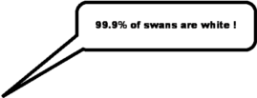
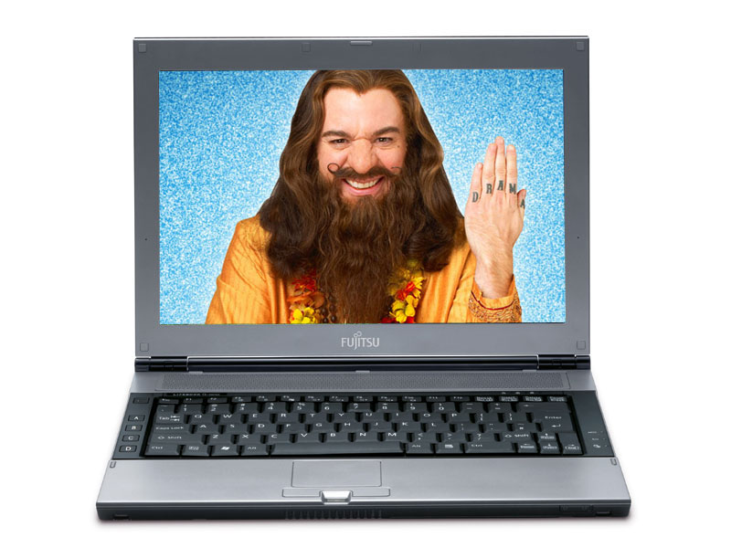
Computer don’t have an emotion.
Pump out the Figures, Facts and Information.
Six Thinking Hats
Notes:
Imagine yourself as a computer. Give facts, figures and information.

Slide 7


Subjective
Impressions
Emotions
Affection
Feelings
Likes & dislikes
Mood
Six Thinking Hats
Notes:
What does red hat expresses ? Emotions, Feelings, Affection, Intuition, Sentiment….

Slide 8
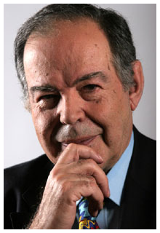
“Exact opposite of White Hat thinking, which is neutral, objective and free of emotional flavor.”
Edward de Bono
Six Thinking Hats

Slide 9
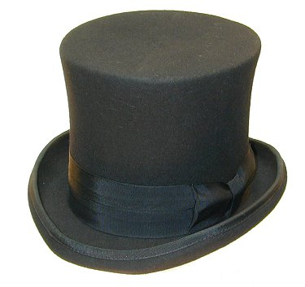
Black Hat
Careful
Judgment
Critical
Logical
Cautious
Pessimistic
Risk Assessment
Six Thinking Hats

Slide 10
Black Hat
We need to consider risks, dangers, obstacles, potential problems and downside of a suggestion
Black Hat thinking is concerned with caution and careful.
Six Thinking Hats

Slide 11
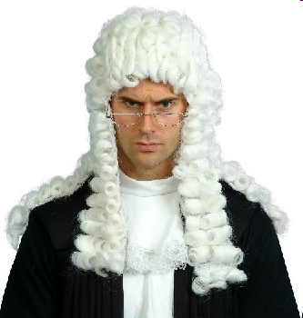
Black Hat
You should think like him !
Six Thinking Hats

Slide 12
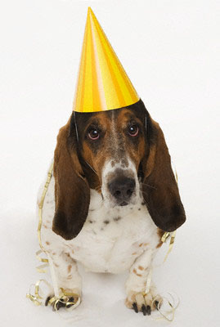
Yellow Hat
Optimism
Hopeful
Positive Thinking
Constructive
Effective
Six Thinking Hats

Slide 13
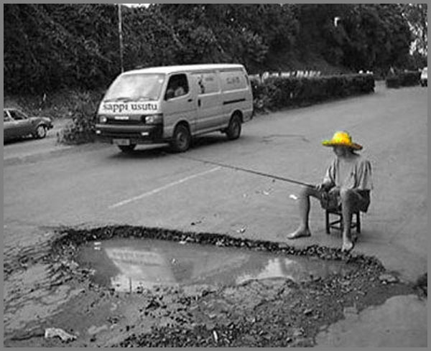
Yellow Hat
“Exact opposite of Black Hat thinking, which is careful, critical and fill with judgment.”
Do you expect to find fish here ?
Six Thinking Hats

Slide 14


Yellow Hat
Yellow hat thinkers thought we should fly like birds, they created Planes!
Black hat thinkers considered risks, dangers, potential problems of it and created parachutes!
Six Thinking Hats

Slide 15
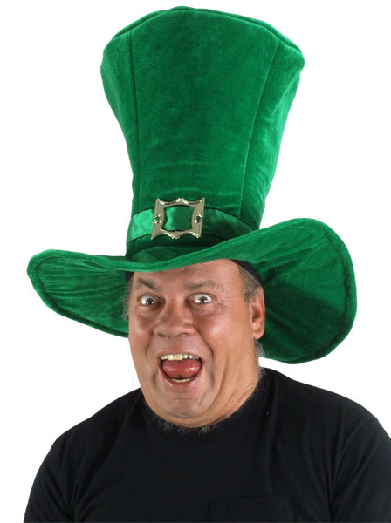
Green Hat
Creative Thinking
Suggestions
Ideas
Proposals
Search for alternatives
What else?
Open minded
Six Thinking Hats

Slide 16
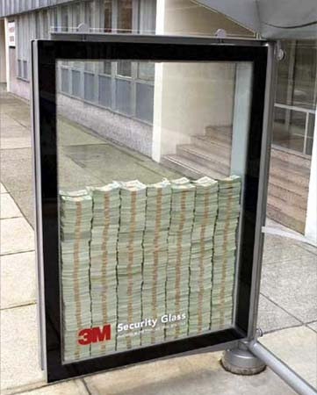
Green Hat
“The Green Hat Thinking is concerned with New ideas and New ways of looking at things.”
Think Creatively
Six Thinking Hats

Slide 17

Blue Hat
Control
Organization of thinking
Control of the other hats
Putting thins in order
Engineering, managerial, programmers, leaders
Six Thinking Hats

Slide 18
Blue Hat
“Blue Hat Thinker is responsible for summaries, overviews and conclusions.”
“Blue Hat Thinker monitors the thinking and ensures that the rules of the game are observed.”
Six Thinking Hats

Slide 19
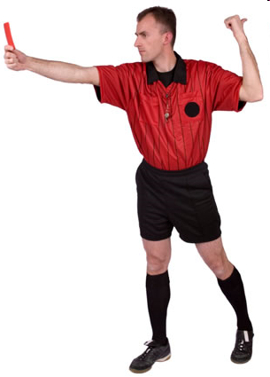
Blue Hat
You are the referee.
Six Thinking Hats

Slide 20

Any questions?

